Slide 1
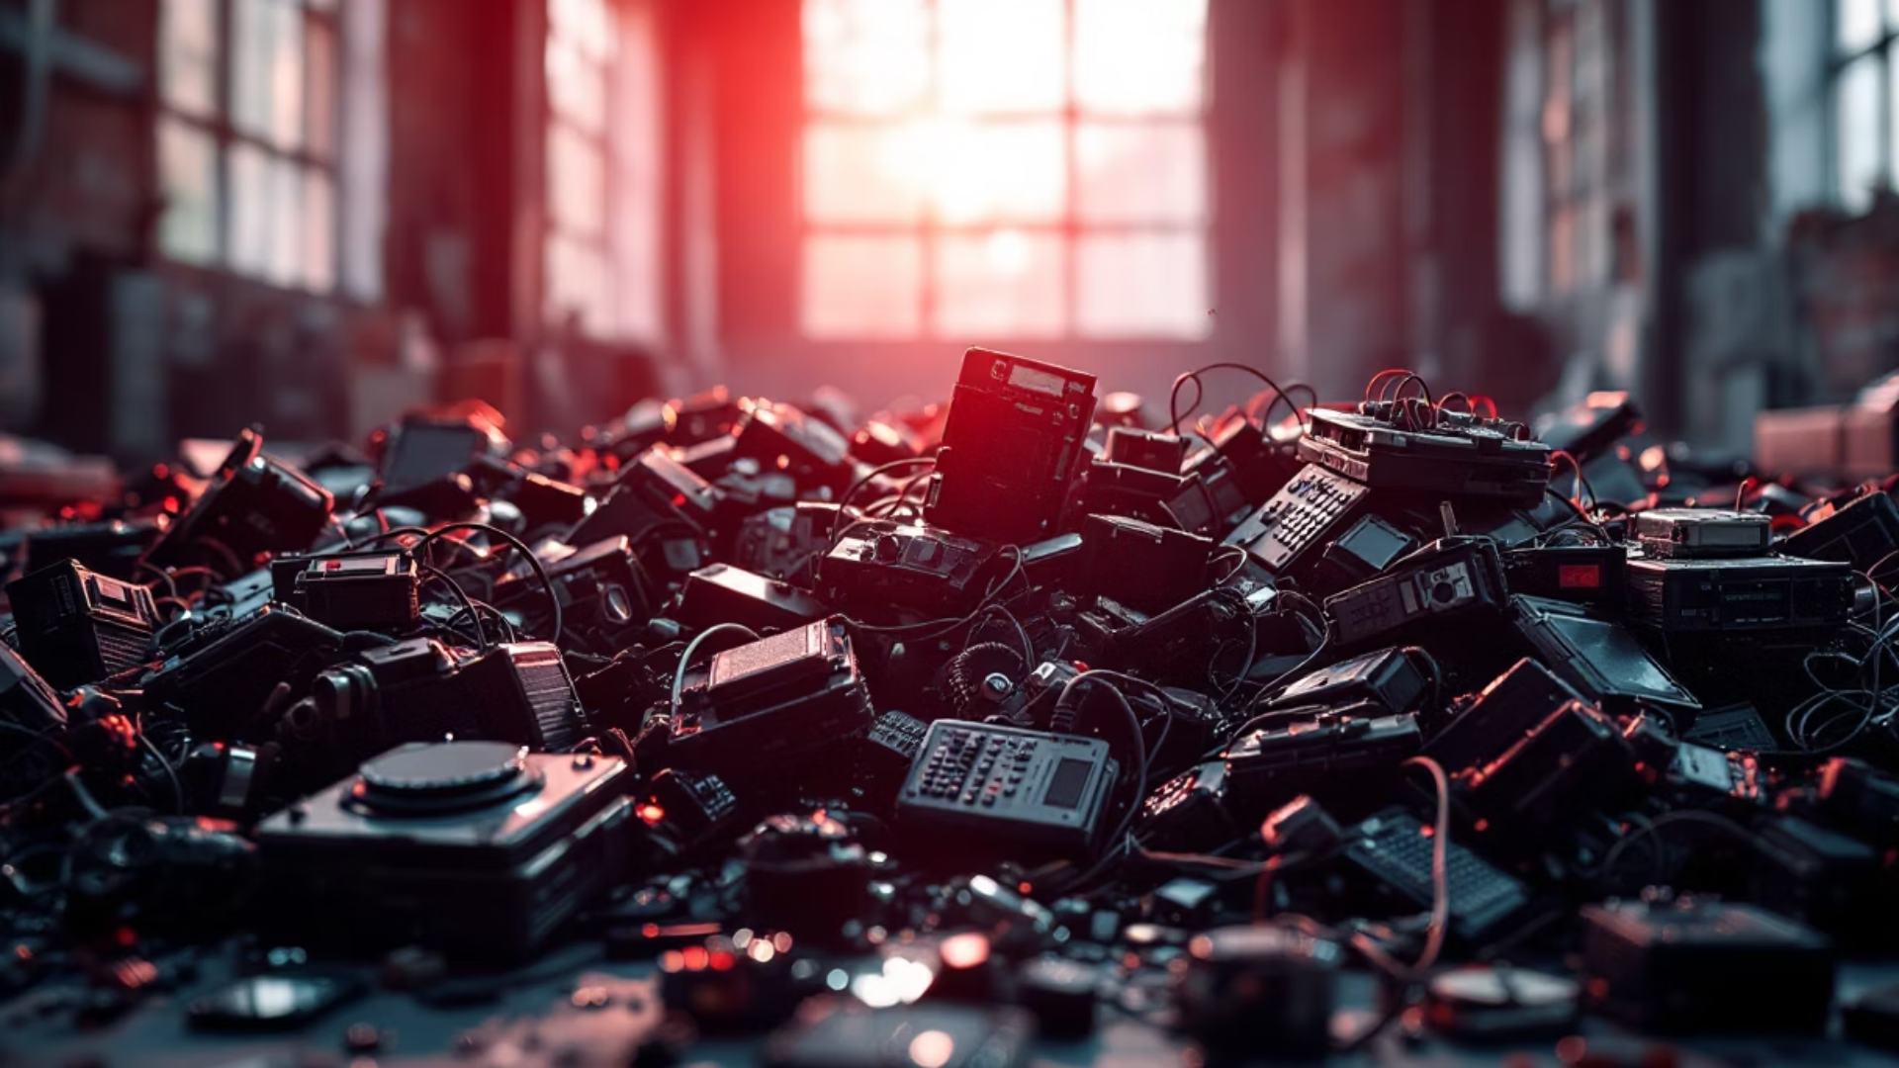
Trash The Tech Right: Tackling Electronic Waste Responsibly
Welcome to Trash The Tech Right, your guide to responsibly managing electronic waste. Learn why proper disposal matters, the impact of e-waste, and how you can make a difference for our planet and health. Together, we can curb the electronic waste crisis!

Slide 2
The Growing E-Waste Crisis: Understanding the Scale and Impact
Each year, over 50 million tons of e-waste are generated worldwide, making it the fastest-growing waste stream. Improper disposal leads to landfills full of toxic elements.
This massive scale worsens pollution, wastes resources, and burdens communities, especially in developing countries where hazardous e-waste is often dumped.
Growing consumer electronics demand
Addressing this crisis requires global awareness and responsible actions from consumers, manufacturers, and governments.
Short device lifespans
Limited recycling infrastructure

Slide 3

Health and Environmental Dangers of Improper E-Waste Disposal
Environmental Pollution
Human Health Risks
Exposure to e-waste toxins can cause respiratory issues, neurological damage, and developmental problems, especially in children.
Heavy metals like lead, mercury, and cadmium leach into water and soil, harming ecosystems and drinking water.
Wildlife Impact
Contaminants affect flora and fauna, leading to biodiversity loss and ecosystem imbalances.

Slide 4

How to Identify Different Types of Electronic Waste in Your Home
Large Appliances
Refrigerators, washing machines, microwaves that require special handling.
Small Household Electronics
Phones, tablets, laptops, and chargers commonly replaced often.
Entertainment and IT Equipment
TVs, printers, gaming consoles, and networking devices.
Lighting and Batteries
Fluorescent lamps and various types of batteries needing careful disposal.

Slide 5
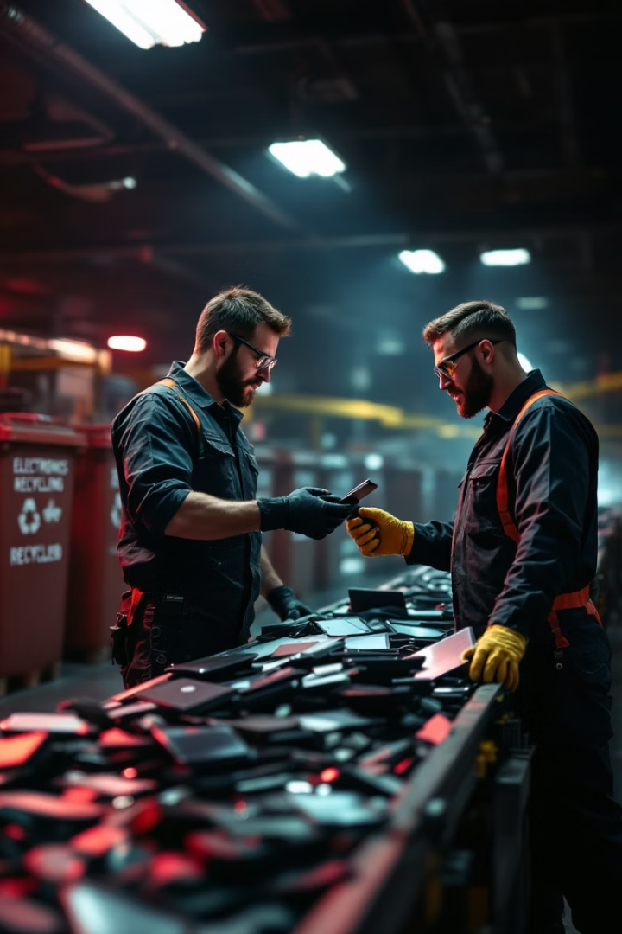
Step-by-Step Guide to Properly Disposing Your Electronic Devices
Backup & Wipe Data
Secure your personal data before disposal by backing up and factory resetting devices.
Find Certified E-Waste Collectors
Locate authorized drop-off points or collection events to safely recycle e-waste.
Donate Working Devices
Consider giving gadgets in good condition to schools or charities.
Recycle Batteries Properly
Separate batteries for special recycling to prevent fire risks and environmental harm.

Slide 6
Local Resources: Finding E-Waste Collection Centers Near You
Municipal Programs
Retailer Take-Back Options
Specialized E-Waste Recyclers
Many cities offer regular collection days or permanent facilities for electronic waste drop-off.
Major electronics retailers often provide recycling services for certain products when purchasing new ones.
Certified companies handle complex e-waste components, ensuring safe material recovery.

Slide 7




Extending Device Lifespan: Repair, Reuse, and Refurbishment Tips
Repair
Fix minor faults early: battery swaps, screen replacements, or software updates.
Reuse
Repurpose old tech for secondary tasks like media servers or kids’ education devices.
Refurbish
Buy or donate refurbished electronics to reduce demand for new products and waste.

Slide 8





Join Our Movement: Community Initiatives and How You Can Help
Raise Awareness
Share knowledge on e-waste hazards and solutions within your community.
Organize Cleanups
Participate or lead local e-waste collection drives and recycling events.
Advocate Policy
Support regulations for responsible manufacturing and waste management.
Practice Responsible Disposal
Commit to recycling and extending the life of your devices.

